Slide 1
Safeguarding Across Primary Care Jane Jones Deputy Director of Safeguarding

Slide 2
Key Legislation that drives our
determination & Vision:
To protect and safeguard
To enable and empower
Addressing causes of the cause
Address health inequalities
Deliver equity of access to high quality, evidence based services
Work in partnership to improve public health outcomes
Implement Legislation
Assurance of Commissioned Services
Partnership Strategy Development
Safeguarding Children Partnership and Adult Boards
Duty to Co-operate
Policy Development
Training
Supervision
Access to advice and support
Leaning to improve
Proactive and reactive support
Complex Case Management
In law Safeguarding statue via
NHS Constitution, Children Act 1989, 2004, Children and Families Act 2014, Children and Social Care Act 2017, NHS Accountability Framework 2022, DoH Promoting the Health of LAC 2015, Working Together to Safeguard Children 2023, Intercollegiate Roles and Competencies: Looked After Children, Children and Adult, Care Act 2014, Domestic Abuse Act, Mental Capacity Act 2005, Modern Slavery 2015, Human Rights 1998 and more ……………

Slide 3
Work Programme
Statutory
Assurance, Effectiveness & Scrutiny, services commissioned or delivered in geographical area through a Population health lens
Risks outside the Home-Children and Adult Exploitation, FGM, Modern Slavery
Neglect, Abuse
PREVENT
Young people transitioning to Adulthood
Digital & Data Programmes, Health Care record, Child Protection Information Systems
Mental Capacity/Deprivation of Liberties/Liberty Protection Safeguards ​
Health Partnerships, collaboration, connectivity, training & workforce
System Improvements Learning and Death reviews
Research in practice, academic evaluation
Children In Care and Care Leavers
Duty of Partnership
Equal partners in Children’s Safeguarding Partnership
Equal partner Child Death Reviews
Care Act – Adults Safeguarding Boards
Responsible Body for MCA Amendment Act
Corporate Parent
Contest Board
Duty to co-operate
Serious Violence Duty
Domestic Abuse ​Act
Responsiveness
​Voice of the CYP and vulnerable individual
Resilience and health and wellbeing of our workforce
Workforce development, opportunities
Trauma informed Lancashire and south Cumbria

Slide 4
ICB Safeguarding Governance Structure
ICB Board
ICB Quality Committee
Networks
ICS Safeguarding Strategy & Assurance Group (Qly)
CNO Meeting
Children in Care Professionals
Multiple Professional Huddles
ICS Leaders Business & Assurance Meeting (Qly)
ICB Safeguarding Leadership Team (Bi-Mthly)
ICB Safeguarding SMT (Weekly)
Desi Dr, Named GP Named Dr & CiC (mthly)
HOS Provider Collaborative
System Leaders Best Practice Network
Safeguarding Strategy and Annual Planning session x2 yearly
ICB Placed Based Assurance Meeting (Qly)
Collaborative Forums
Multi Agency – (Qly)

Slide 5
Partnership Duty - Safeguarding Case Reviews Q1 and Q2
Publications: Q1 and Q2
CSPRs Case of Lily (April 2024) CSPR Aiden (September 2024) CSPR Olivia (September 2024) SARs SAR Poppy (September 2024) DHRs DHR Ella (June 2024) DHR Anne (December 2023)
​
Learning Themes: Q1 and Q2
Substance and alcohol misuse- recognition and signpost to dual diagnosis pathway | Supporting people with complex needs and the value of multi-agency collaboration
Assessment of risk factors in relation to vulnerability | Escalation process for frontline workers to access timely response
Intrafamilial Sexual Abuse | Physical abuse – salt poisoning
Mental ill health /MCA implementation | Adult child to parental abuse
Suicide | Neurodiversity

Slide 6
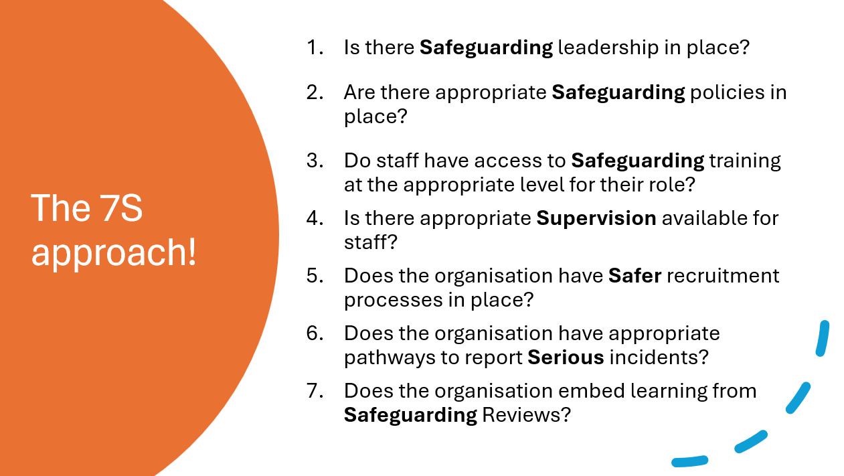
Safeguarding Assurance

Slide 7
Support for Services
Safeguarding Advice and Support Line
Named GP model in place to allow full week coverage
Sample policies in place on Safeguarding Adults, Children, Prevent and MCA have previously been circulated for Practices to adopt, sample policies will move towards a checklist approach for practices to benchmark against
Training offer includes Partnership training, ICB Lunch and Learn and bespoke training
Regular safeguarding bulletin with key updates, learning points and useful contacts
Safeguarding page within the Hub for resources and training.
Ad hoc support as requested

Slide 8
Our Proposals…………….
Continue to work closely across primary care, quality and safeguarding including proactive visits, response to incidents
Raise awareness of support
Continued development of audit and assurance processes, safeguarding benchmark across POD Services this year
Review and refresh of messaging, intranet, training and touch points
Consider future support and training
Transition and Reform – the caveat

Slide 9
NOTIFICATION - The contact details for the ICB Safeguarding Team
We have a single telephone number and email address for ICB, Provider and Partners.
Please use to access advice and raise any concerns, including Director escalation if required.
Tel: 0300 373 3600
Email: lscicb.safeguarding@nhs.net
This single point of contact is manned daily with a safeguarding practitioner duty rota in place to ensure timely response to your queries and access to safeguarding advice.
NB: This replaces the four numbers previously held for the CCG teams.

